Slide 1
UFC
Events (1993-2023)
Data Storytelling Project
SIDDHAM SINGH RAO AND SHIVANG KAINTHOLA

Slide 2
Index
Introduction
About the dataset Disclaimer
For all UFC events* The venues The firsts
Across all fights Across all fighters
Across all weight classes Over the years Across all events
The chances Implementation and References
3
6
7
8
9
10
12
18
22
26
31
32
36

Slide 3
Introduction
This project is my first attempt at data storytelling / data analysis. As someone who is a big fan of mixed martial arts as a sport, I find it it intriguing to examine the underlying data. For readers unfamiliar with the UFC and mixed martial arts, I have included an introduction.
The dataset contains information about events and individual bouts, since I do not have any scientific or business objectives, I have explored this dataset based on questions that popped up in my mind, and ones I thought would be interesting.
This is reflected in the questions I am answering and the nature of the facts I have produced in this report, some of which may already be well-known, some might be interesting, and some even absurd.
I will be following this up with a similar project on a different UFC dataset, and I openly welcome any suggestions, criticisms, and any feedback.
Sk
3

Slide 4

What is MMA ?
Mixed Martial Arts (MMA) is a full- contact combat sport that allows a wide variety of fighting techniques and skills from various martial arts and combat sports to be used in competition.
It typically combines techniques from disciplines such as boxing, kickboxing, Muay Thai, Brazilian Jiu-Jitsu, wrestling, judo, and other martial arts, both striking and grappling.
MMA fights take place inside a ring or a fenced enclosure called the cage for 3 or 5 rounds (for championships).
Each round is five minutes in duration, with one minute of rest in between.
4

Slide 5
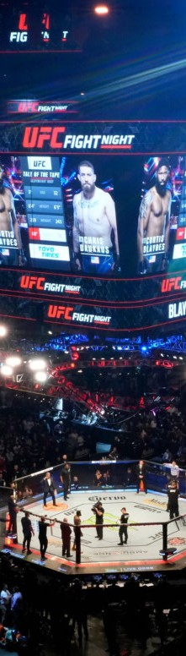
What is the
UFC ?
Founded in 1993, the UFC (Ultimate Fighting Championship) is a leading global MMA organization, dominating PPV events and media content.
UFC hosts global events in the Octagon, featuring elite fighters, broadcasted on TV and digital platforms, with millions of viewers.
Weight classes in the ufc
range from Strawweight (115 lbs) to Heavyweight (265 lbs) for men, and Strawweight (115 lbs) to Featherweight (145 lbs) for women, and fights contested when a fighter fails to make weight is considered as catch-weight.
In the UFC, main events and championship bouts are set for 5 rounds, while all other bouts are set for 3 rounds.
5

Slide 6
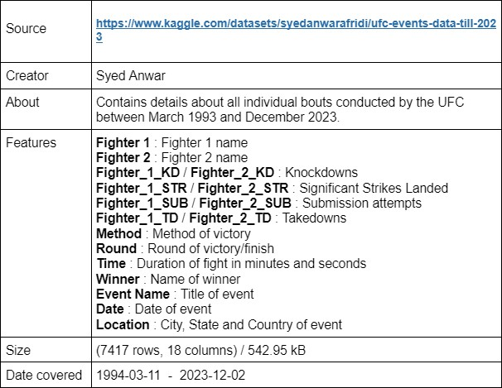
About the dataset
The dataset covers all bouts between and including UFC 2
and UFC 284.

Slide 7
Disclaimer
The facts in this project are directly based on my findings from the dataset. Some findings may be incorrect or out of date due to the limitations of the dataset,
Many details are skewed due to the fact of some fighters, weight classes, venues and bouts are more prevalent and actively promoted or contested than others.
Some images added here for representation may be graphic.

Slide 8

What is the total number of bouts covered ?
The dataset covers 7416 bouts.
What is the average duration of a fight ?
On an average, a fight has lasted 3min : 47s .
What round did most fights end in ?
Most fights ended in the third round, followed by finishes in the first round.
What is the most popular method of finish ? Most fights ended by Unanimous Decision.
For all events
(1993-2023)

Slide 9
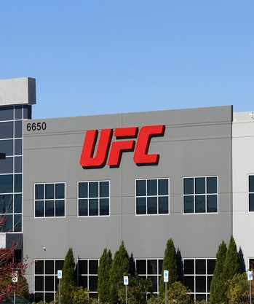

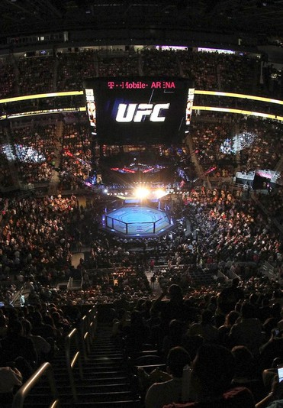
The venues
LAS VEGAS, NEVADA
Including the T-Mobile arena, this venue has seen over 2411 bouts.
ABU DHABI, UAE
The place that gave the UFC a lifeline during the 2020 pandemic, has seen 196 bouts.
LONDON, UNITED KINGOM
Landing across the channel in UFC 38, United Kingdom has hosted 170 bouts.

Slide 10
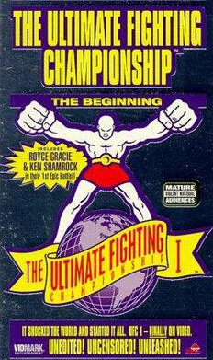
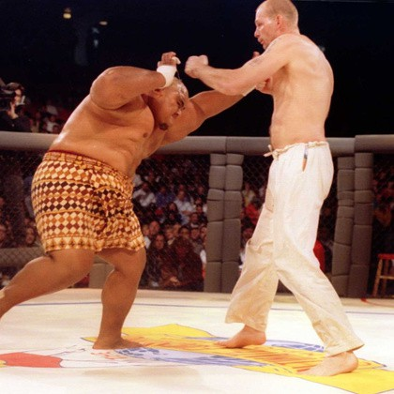
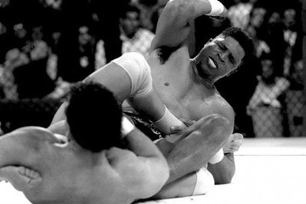
The ‘firsts’
Where was the first UFC fight held ?
The first UFC event ever was in Denver,Colorado.
Which male fighter won the first knockout in UFC ?
Gerard Gordeau won the first knockout in UFC in the first round.
Which male fighter won the first submission ?
Patrick Smith won the first submission in UFC, also in the first round.
10

Slide 11
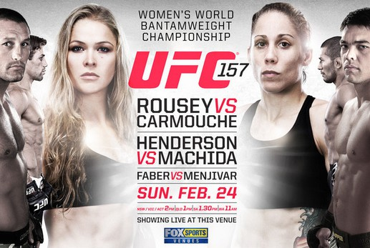

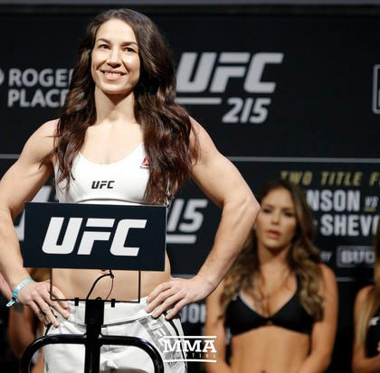
Who was the first female UFC fighter ?
Ronda Rousey fought Liz Carmouche at UFC 157 and secured a win by armbar, the first submission win in the first round in the ufc.
Which female fighter won the first knockout in UFC ?
Cat Zingano won the first round knockout in UFC.
Which female fighter won the first first round knockout?
Sara McMann won the first first round knockout in UFC.
11

Slide 12
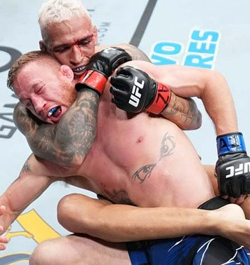
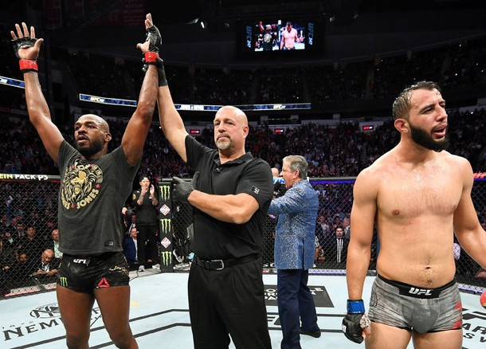
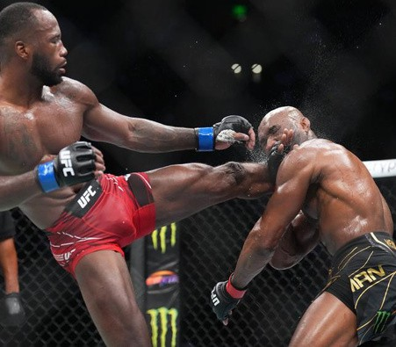
Across all fights
2609
bouts ended via
unanimous decision.
704
bouts ended via
split decision.
2436
bouts ended via
KO/TKO
1468
bouts ended via
submission

Slide 13
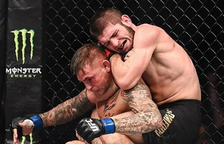
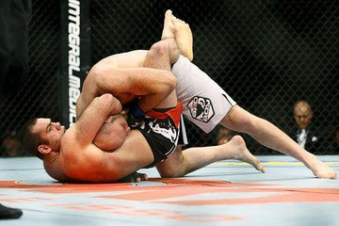
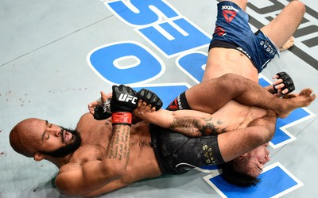
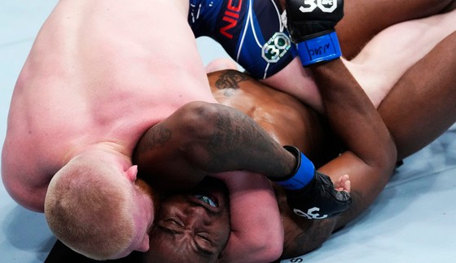
Submissions
563
bouts ended by
rear naked choke.
262
bouts ended by
guillotine choke.
191
bouts ended by a form of
armbar.
104
bouts ended by
arm triangle.

Slide 14
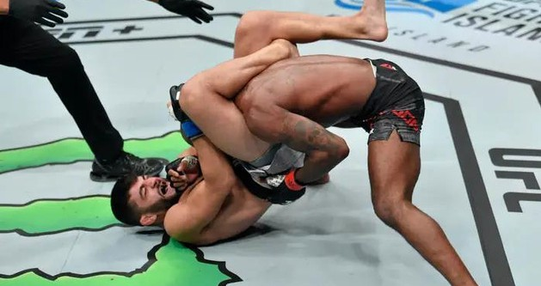
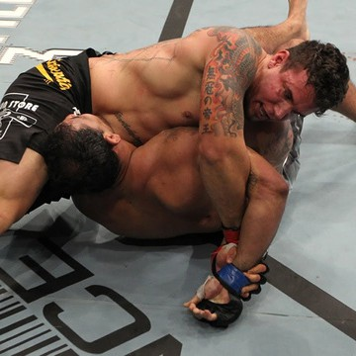
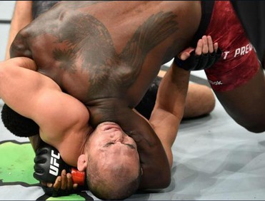
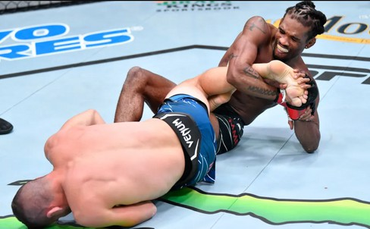
92
bouts ended by triangle choke.
41
bouts ended by
kimura.
Von Flue Choke (Shoulder Choke)
Toe Hold
were the rarest submissions, happening only once each.

Slide 15
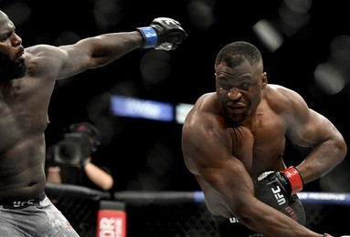
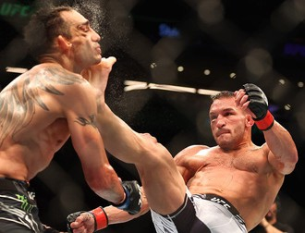
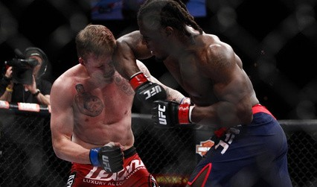
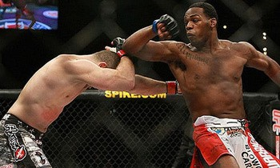
Knockouts
1726
bouts ended by
punch / punches.
181
bouts ended by a kick knockout.
160
bouts ended by a elbow strike (or strikes) knockout.
7
bouts ended by a
spinning back elbow strike knockout.

Slide 16
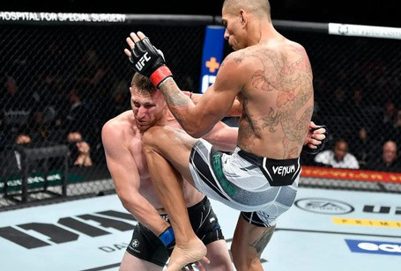
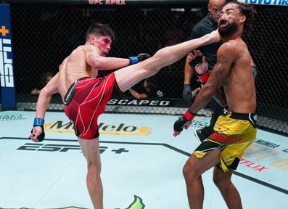
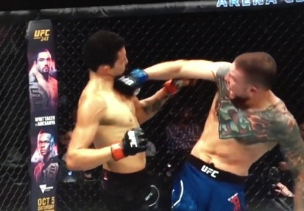
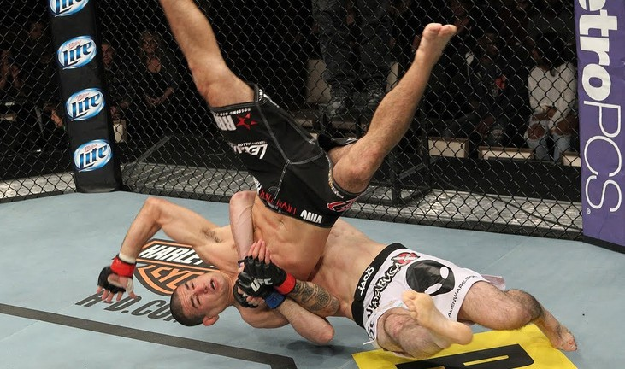
34
bouts ended by flying knee knockout.
10
bouts ended by
a spinning back kick and a spinning back fist each.
14
bouts ended by a slam knockout.
149
bouts ended with a KO/TKO by a combination of strikes.

Slide 17
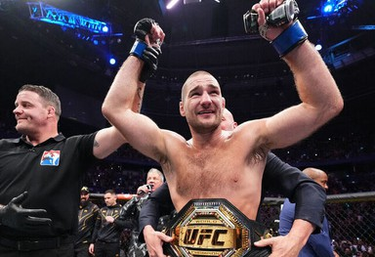
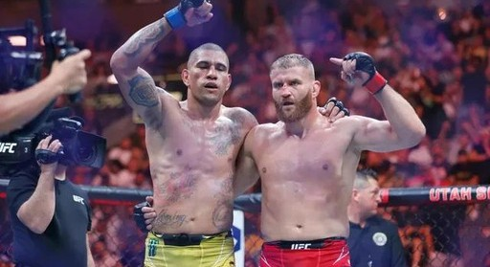
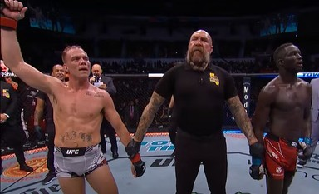
Decisions
2609
bouts ended by
unanimous decision.
704
bouts ended by a split decision.
91
bouts ended by a majority decision.
56
outcomes in all were overturned.
25
bouts were rendered CNC (Could not continue).

Slide 18
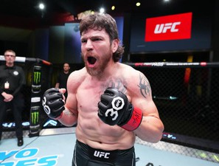
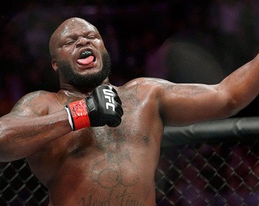
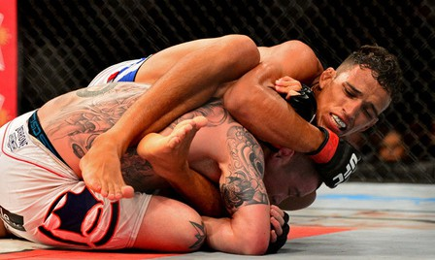
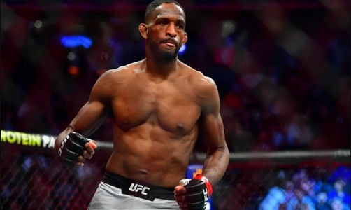
Across all fighters
Men’s weight classes
Jim Miller
has the most wins at 26-16.
Derrick Lewis
has the most knockouts with 14
in the UFC.
Charles Oliviera
has the most submissions
with 16 in the UFC.
Neil Magny
has the most decision wins
at 14 in the UFC.
04
WWW.REALLYGREATSITE.COM

Slide 19
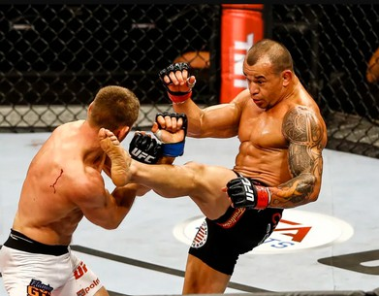
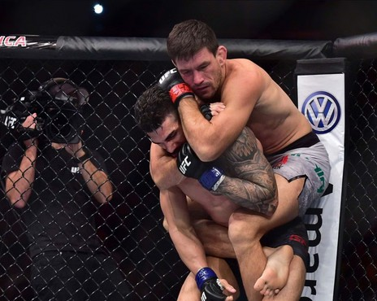
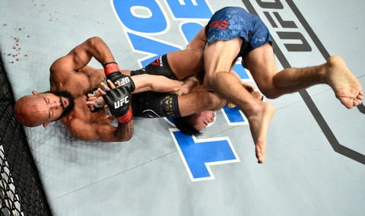
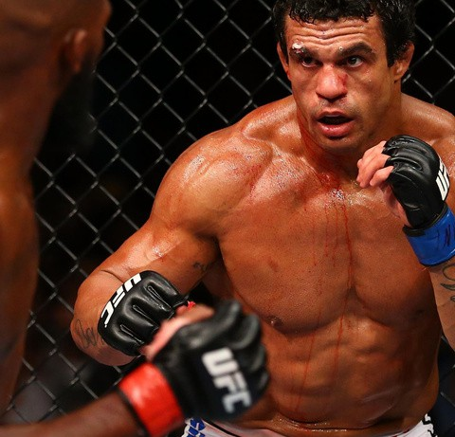
Gleison Tibau
has the most split-decision wins at 7 in the UFC.
Demian Maia
has the most rear naked chokes
with 8 in the UFC.
Demeterious Johnson has the most armbars with 4 in the UFC.
Vitor Belfort
has the most first knockouts in the UFC.
round
04
WWW.REALLYGREATSITE.COM

Slide 20
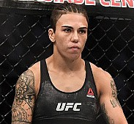
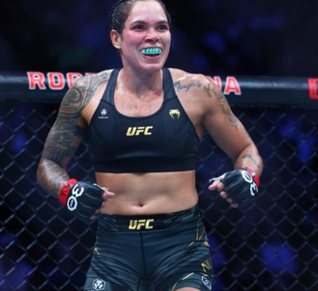
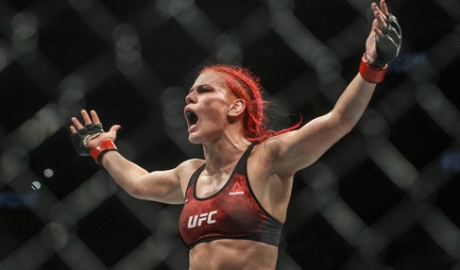
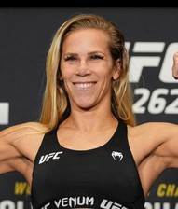
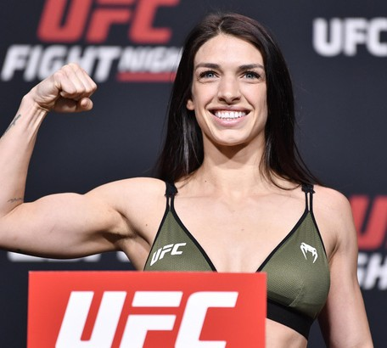
Women’s weight classes
Jessica Andrade has the most wins in the UFC.
Amanda Nunes
had the most knockouts as well as the most first round knockouts
in the UFC.
Gillian Robertson
has the most submissions
as well as the most rear naked chokes
n the UFC.
Katlyn Chookagian has the most decision wins in the UFC.
Mackenzie Dern
has the most first round submissions in the UFC.
04
WWW.REALLYGREATSITE.COM
20

Slide 21
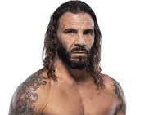
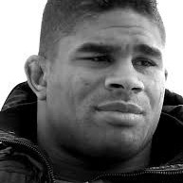

The unfortunate losses
Clay Guida
has lost the most by submission.
Alistair Overeem
has lost the most by knockout in the UFC.
Jeremy Stephens has lost the most by decision in the UFC.
04
WWW.REALLYGREATSITE.COM

Slide 22





Across all weight classes
Top 5 of Knockouts
Top 5 of Submissions
Welterweight : 402
Middleweight : 375
Lightweight : 371
Heavyweight : 362
Light Heavyweight : 290
Lightweight : 288
Welterweight : 239
Middleweight : 216
Bantamweight : 129
Featherweight : 118
First Round Knockouts
Heavyweight LHeavyweight Middleweight Welterweight
Lightweight Featherweight : 102
Bantamweight : 86
Flyweight : 40
: | 68
: | 55
: | 111
: | 119
: | 68
Women’s Featherweight : 3
Women’s Bantamweight : 13 Women’s Flyweight : 24
Women’s Strawweight : 30
04
WWW.REALLYGREATSITE.COM

Slide 23
Top 3 methods of victory
Lightweight
Unanimous Decision: 464
KO/TKO Punch: 134
SUB Rear Naked Choke: 134
Bantamweight
Unanimous Decision: 230
Split Decision: 75
KO/TKO Punch: 67
Middleweight
Unanimous Decision: 297
KO/TKO Punches: 147
KO/TKO Punch: 103
Welterweight
Unanimous Decision: 451
KO/TKO Punch: 137
Split Decision: 123
Light Heavyweight
Unanimous Decision: 189 KO/TKO Punches : 109 KO/TKO Punch: 104
Featherweight
Unanimous Decision: 307
KO/TKO Punch: 81
Split Decision: 74
Heavyweight
KO/TKO Punches : 168
Unanimous Decision: 163
KO/TKO Punch: 124
Flyweight
Unanimous Decision: 129
Split Decision: 40
SUB Rear Naked Choke : 32
04
WWW.REALLYGREATSITE.COM
23

Slide 24
Women’s Flyweight
Unanimous Decision: 98
Split Decision : 29
SUB Rear Naked Choke : 19
Women’s Bantamweight
Unanimous Decision: 89
Split Decision: 25
KO/TKO Punches: 17
Women’s Strawweight
Unanimous Decision: 144
Split Decision : 38
SUB Rear Naked Choke : 28
Women’s Featherweight
Unanimous Decision: 12
Split Decision: 4
SUB Rear Naked Choke : 3
In the men’s division, the Lightweight division had the most bouts (1288), followed by the Welterweight division (1247) and the Middleweight division (989).
In the women’s division, the Strawweight division had the most bouts (285), followed by the Flyweight division (212) and the Bantamweight division (194).
04
WWW.REALLYGREATSITE.COM

Slide 25
BOUTS RENDERED CNC
Overturned / CNC
OVERTURNED BOUTS
Welterweight: 9
Light Heavyweight: 9
Bantamweight : 8
Heavyweight : 8
Lightweight : 6
Middleweight : 6
Featherweight : 5
Flyweight : 2
Women’s Bantamweight : 2
Lightweight: 7
Bantamweight : 5
Light Heavyweight : 3
Middleweight : 3
Featherweight : 3
Heavyweight: 2
Welterweight : 2
The bantamweight division has had the most bouts overturned or rendered CNC, followed by the lightweight division.
04
WWW.REALLYGREATSITE.COM

Slide 26
Over the years
Year |  | Knockouts |  | Submissions |  | Decisions
1994 |  | 10 |  | 19 |  | NA
1995 |  | 11 |  | 18 |  | 3
1996 |  | 23 |  | 9 |  | 4
1997 |  | 12 |  | 18 |  | 8
1998 |  | 7 |  | 7 |  | 7
1999 |  | 26 |  | 7 |  | 11
2000 |  | 14 |  | 11 |  | 17
2001 |  | 17 |  | 9 |  | 12
2002 |  | 29 |  | 8 |  | 15
2003 |  | 18 |  | 8 |  | 14
2004 |  | 18 |  | 11 |  | 10
2005 |  | 39 |  | 21 |  | 19
2006 |  | 59 |  | 47 |  | 52
2007 |  | 53 |  | 54 |  | 62
 |  |  |  | 26

Slide 27
2008 | 85 |  | 51 | 64
2009 | 75 |  | 46 | 92
2010 | 69 |  | 59 | 124
2011 | 95 |  | 55 | 147
2012 | 105 |  | 70 | 158
2013 | 130 |  | 67 | 179
2014 | 152 |  | 95 | 247
2015 | 155 |  | 88 | 221
2016 | 153 |  | 89 | 248
2017 | 146 |  | 80 | 224
2018 | 151 |  | 90 | 229
2019 | 153 |  | 80 | 277
2020 | 139 |  | 82 | 226
2021 | 171 |  | 73 | 256
2022 | 171 |  | 98 | 239
2023* | - | 27 | - | -

Slide 28
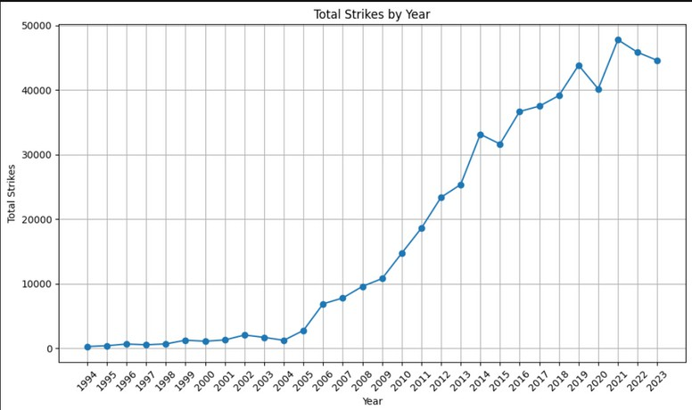
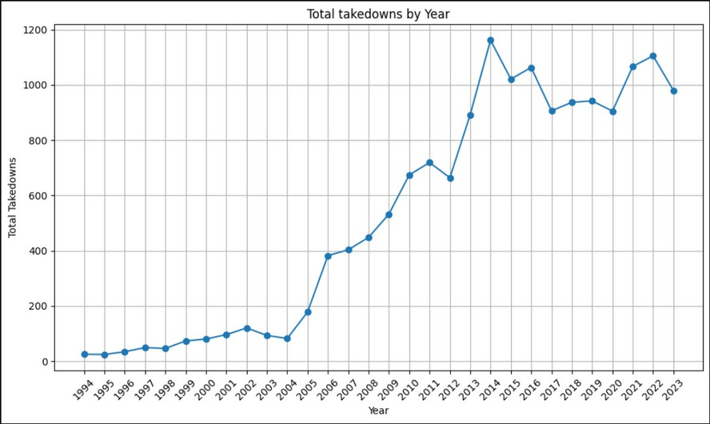
Significant strikes over the years
Takedown attempts over the years
WWW.REALLYGREATSITE.COM
28

Slide 29
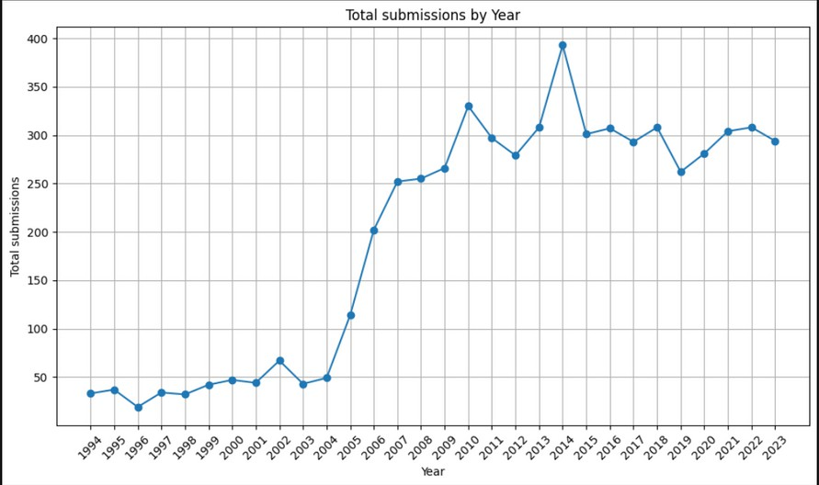
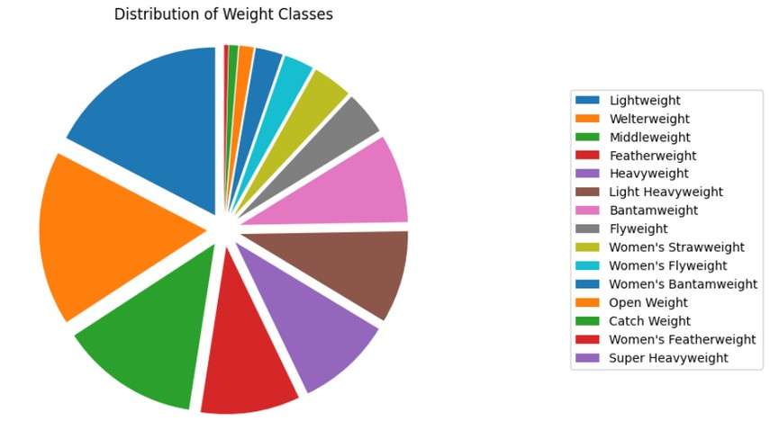
Submission attempts over the years
Total number of fights over all weight classes
29

Slide 30





What round did fights end in ?
Round 1 Round 2 Round 3
Round 4
Round 5
271
Round 5
Round 1
2123
Round 3
3735
Round 2
1241
This would reflect the fact that only main event or championship fights are scheduled for five rounds thus the majority of events are of three rounds, and the most popular form of finish is decision (at the end of bouts).
30

Slide 31




ACROSS ALL EVENTS
UFC 2 had the most submissions.
UFC 199 had the most knockouts.
UFC Fight Night: Nelson vs. Story had the most decision wins.
UFC 222 had the most split decision wins.
31

Slide 32


85.02%
The chances against an opponent
times having landed more significant strikes landed led to a KO/TKO victory.
38.92%
times having landed more significant strikes landed led to a submission victory.
04
32

Slide 33


54.58%
times having made more takedown attempts led to a decision victory.
53.68%
times having made more takedown attempts led to a submission victory.
19.24%
times having made more takedown attempts led to a KO/TKO victory.
04
WWW.REALLYGREATSITE.COM

Slide 34



13.83%
times having made more submission attempts
led to a KO/TKO victory.
87.04%
times having made more submission attempts led to a submission victory.
41.96%
times having made more submission attempts led to a decision victory.
04
WWW.REALLYGREATSITE.COM

Slide 35
Fighter names starting with ‘J’ have had the most wins as well as the most losses.
Most submission wins have been observed to happen in December.
Most knockouts have been observed to happen in July.
All CNC outcomes have occured in the first or second round only.
Selected at random, a fight has the highest probability of being in the ‘Lightweight’ division and going to a decision.

Slide 36
Implementation
This data analysis project was done with Python using the Pandas library.
The code can be found in the Jupyter Notebook in this repository .
References
All images belong to the respective owners.
I would also like to appreciate @THE_ART_OF_MMA for the fantastic art piece I have used for the cover.
The links to the images can be found here
36

Slide 37
Thank You ......!

